Slide 1
iFood Marketing Prediction Model
Data Set: https://www.kaggle.com/datasets/jackdaoud/marketing-data/data?select=ifood_df.csv

Slide 2

Executive Summary
Problem Statement:
In retail marketing, the opportunity cost of missing a potential customer is significantly higher than the marginal cost of sending an additional advertisement. Therefore, a high-sensitivity model is required.
Objective:
To develop a predictive model using machine learning to identify customers with a high probability of responding to the next campaign based on their demographics, purchasing behavior, and historical engagement.
Primary KPI:
Recall: The main metric.
AUC-ROC: The auxiliary metric.

Slide 3
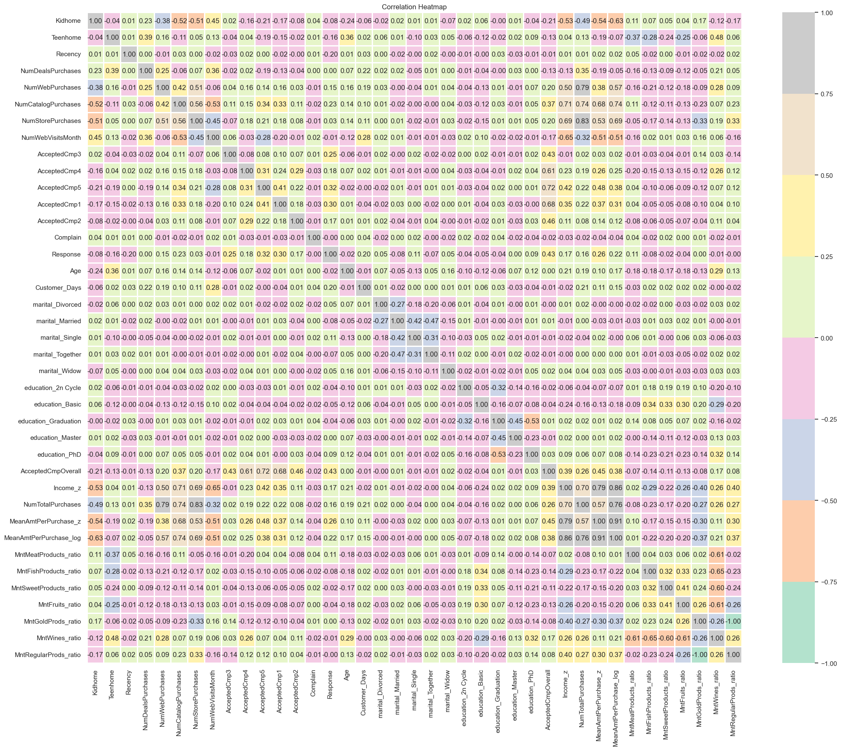
Execution Process - Data Exploration & Pre-processing (EDA)
Data Cleaning:
Handled missing values and infinity values to ensure mathematical stability.
Feature Engineering:
Identified and removed highly correlated variables
Select key performance drivers
Transformations:
Applied Log-transformation to skewed numerical features (e.g., Income) and performed Z-score normalization for scale consistency.

Slide 4

Model Selection
A comparative analysis was performed across several industry-standard algorithms:
Random Forest: Established a robust baseline.
XGBoost / LightGBM: Demonstrated high precision but remained conservative in capturing the minority class (responders) under imbalanced conditions.
CatBoost (Selected): Emerged as the winner due to its superior handling of categorical features and symmetric tree structure, which yielded the highest Recall rates.
 | XGBoost | RandomForest | Catboost
F1 Score | 0.5505 | 0.67 | 0.61
Precision | 0.7143 | 0.47 | 0.55
Recall | 0.4478 | 0.36 | 0.70
AUC Score | 0.8944 | 0.8753 | 0.9092

Slide 5
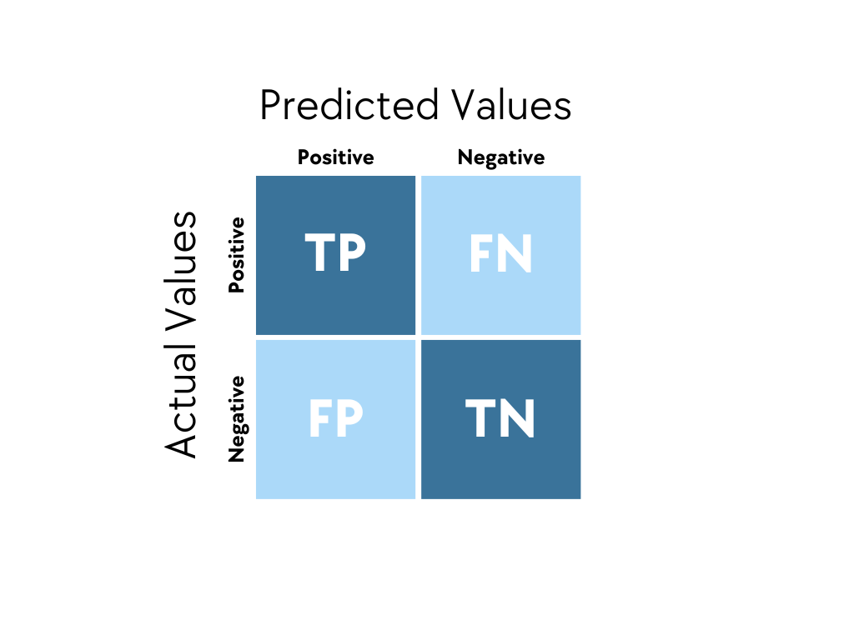
Why Recall Rate? Why CatBoost? (1/2)
Confusion Matrix
A tabular performance evaluation tool for machine learning classification algorithms that displays the number of correct and incorrect predictions, broken down by class.

Slide 6
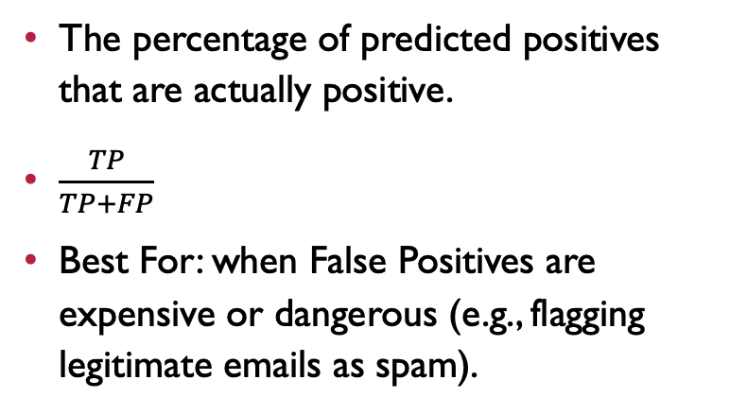
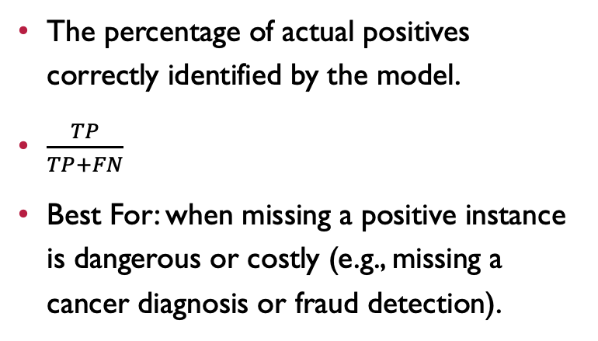
Why Recall Rate? Why CatBoost? (2/2)
Percision
Recall Rate
The percentage of predicted positives that are actually positive.
$\frac{TP}{TP+FP}$
Best For: when False Positives are expensive or dangerous (e.g., flagging legitimate emails as spam).
The percentage of actual positives correctly identified by the model.
$\frac{TP}{TP+FN}$
Best For: when missing a positive instance is dangerous or costly (e.g., missing a cancer diagnosis or fraud detection).
In this case, we assume the marketing budget is sufficient, and we want to detect as many positive responses as possible. Therefore, Recall Rate will be considered as a major measure index.
Notes:
T

Slide 7
Optimization: Ensemble Undersampling
To address the severe class imbalance (approx. 1:6 ratio), an Ensemble Undersampling strategy was implemented:
Implementation
Aggregation
The majority class (non-responders) was split into three distinct subsets.
Final predictions were derived by averaging the probabilities from all three models.
Each was paired with the full set of minority samples (responders) to train three separate sub-models.
Observation: This approach improved model stability and generalization. While the improvement over a single CatBoost model was marginal, it ensured a more comprehensive learning of the majority class distribution.
 | Original | Ensemble
F1 Score | 0.61 | 0.6289
Precision | 0.55 | 0.5435
Recall | 0.70 | 0.7463
AUC Score | 0.9092 | 0.9090

Slide 8

Results and Analysis
Model Performance Metrics
Recall Rate:
Achieved the highest level using the CatBoost Ensemble, successfully identifying the vast majority of potential responders.
AUC Score:
Consistently maintained above 0.90, proving excellent discriminatory power.
Confusion Matrix Analysis:
Under the assumption of an "ample budget," we successfully optimized for the "Cost of Omission," accepting a higher number of False Positives to ensure the lowest possible False Negatives.

Slide 9
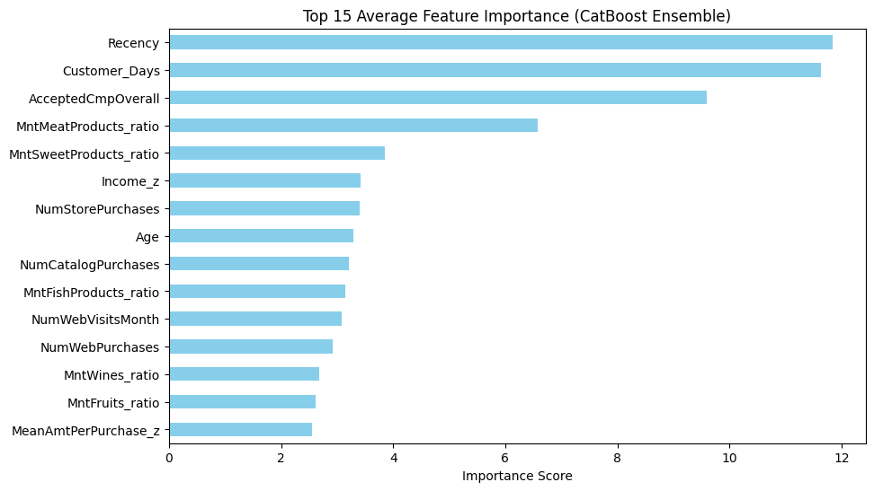
Key Success Factors (Feature Importance)
The Top 3 drivers
Recency
Customer Days
Accepted Any Comp Before

Slide 10
Conclusion & Action Plan
Strategic Recommendation
Given the high Recall rate provided by CatBoost, the marketing department should target all customers predicted as "1" by the model to maximize campaign reach.
Budget Allocation
Since the budget is sufficient, the probability threshold can be further lowered (e.g., from 0.5 to 0.4) to expand the target list and ensure maximum conversion.
Future Work
Future iterations should incorporate dynamic data, such as "discount preference" or "web clickstream data," to refine Precision without sacrificing current Recall levels.

